Slide 1
Getting started with collaboration on GitHub:
Crunching webinar attendance data with R and Shiny

Slide 2






Notes:
The popularity of webinars and similar online events has increased in the last few years, but for an analyst involved in hosting, the lack of quality and accurate data about participation in the event was infuriating.
This project started life with frustration in a spreadsheet, moving to a simple script in R.

Slide 3
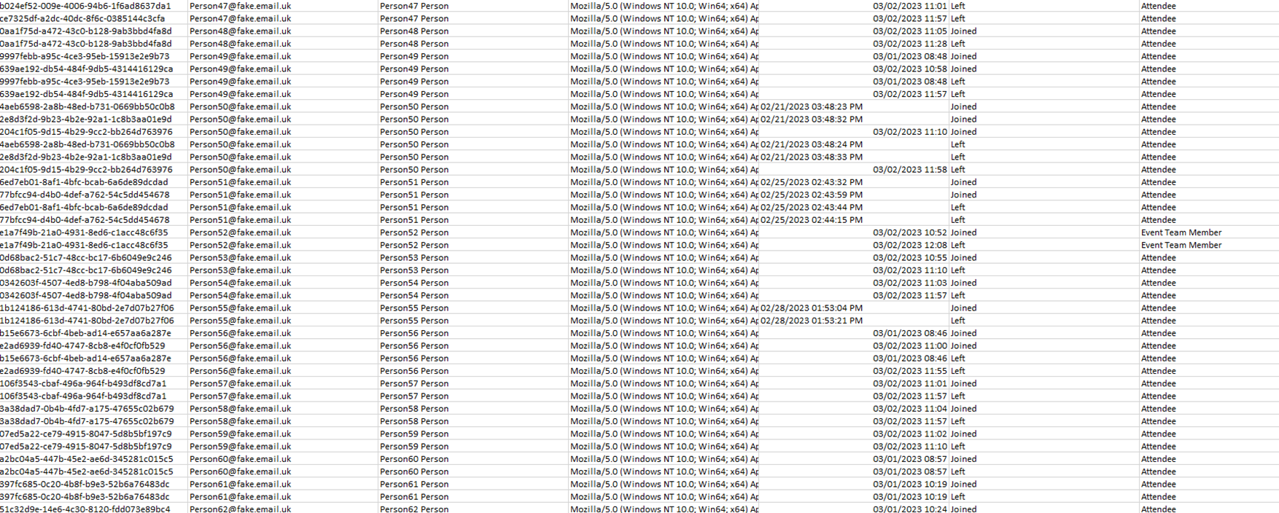




Notes:
Mess in the spreadsheet exported by teams

Slide 4


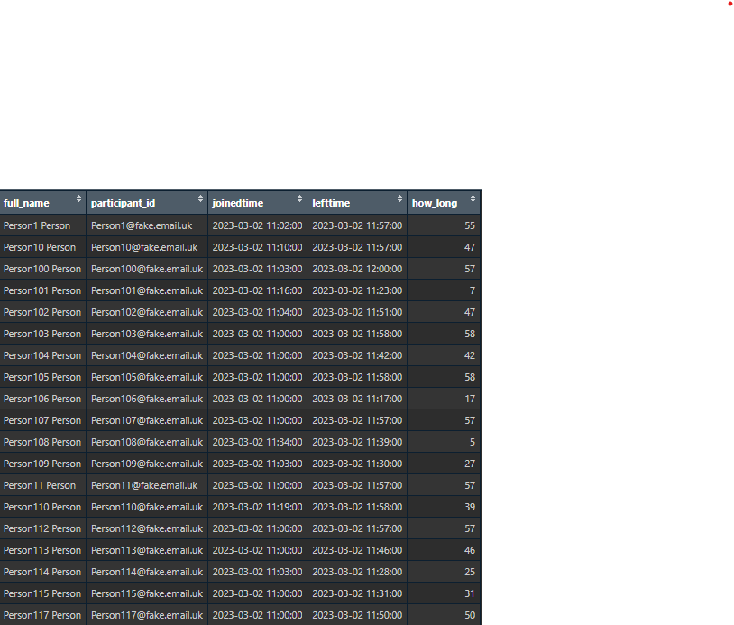
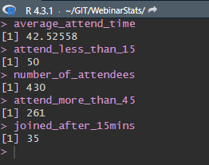
Notes:
Wrote about 70 lines of code to get to this

Slide 5
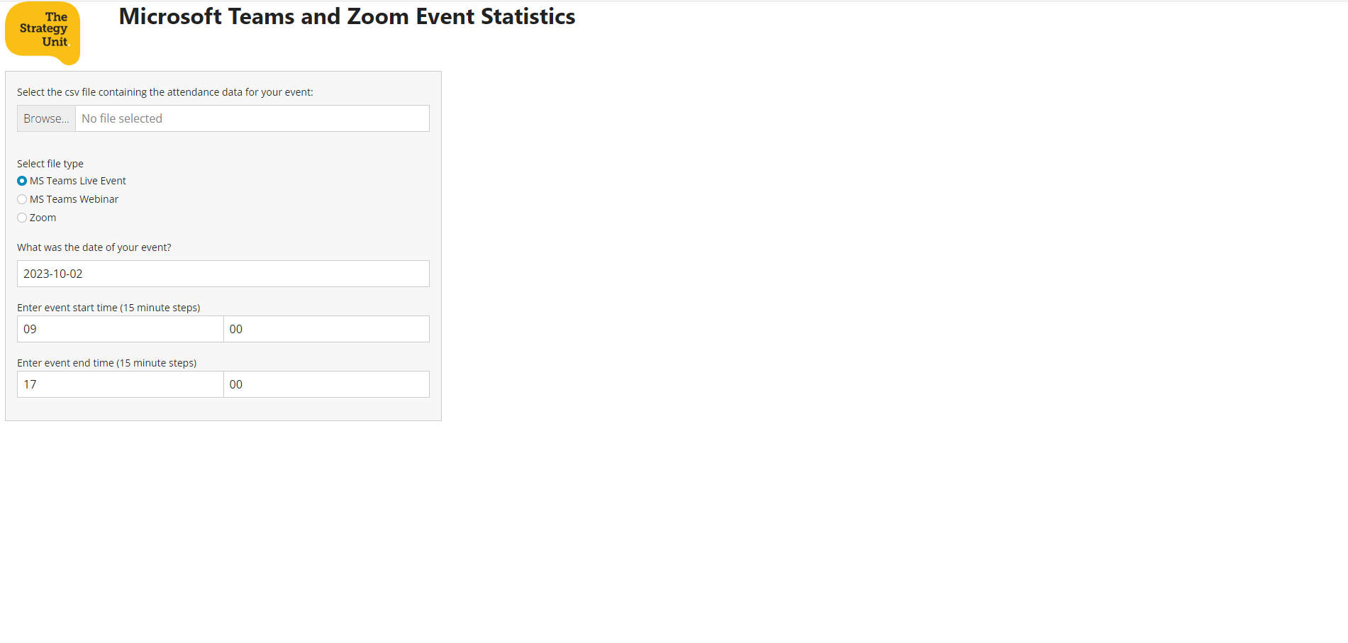
Notes:
Conversations with colleagues showed there was interest in something more and before long ideas had formed of something in Shiny and an early prototype was underway. This led to a public repository on GitHub, a demonstration to colleagues, and involvement of others; contributing issues, suggesting ideas and developments. The project has served a dual purpose, as a useful tool, and as a vehicle from which to practice collaborating via GitHub.

Slide 6
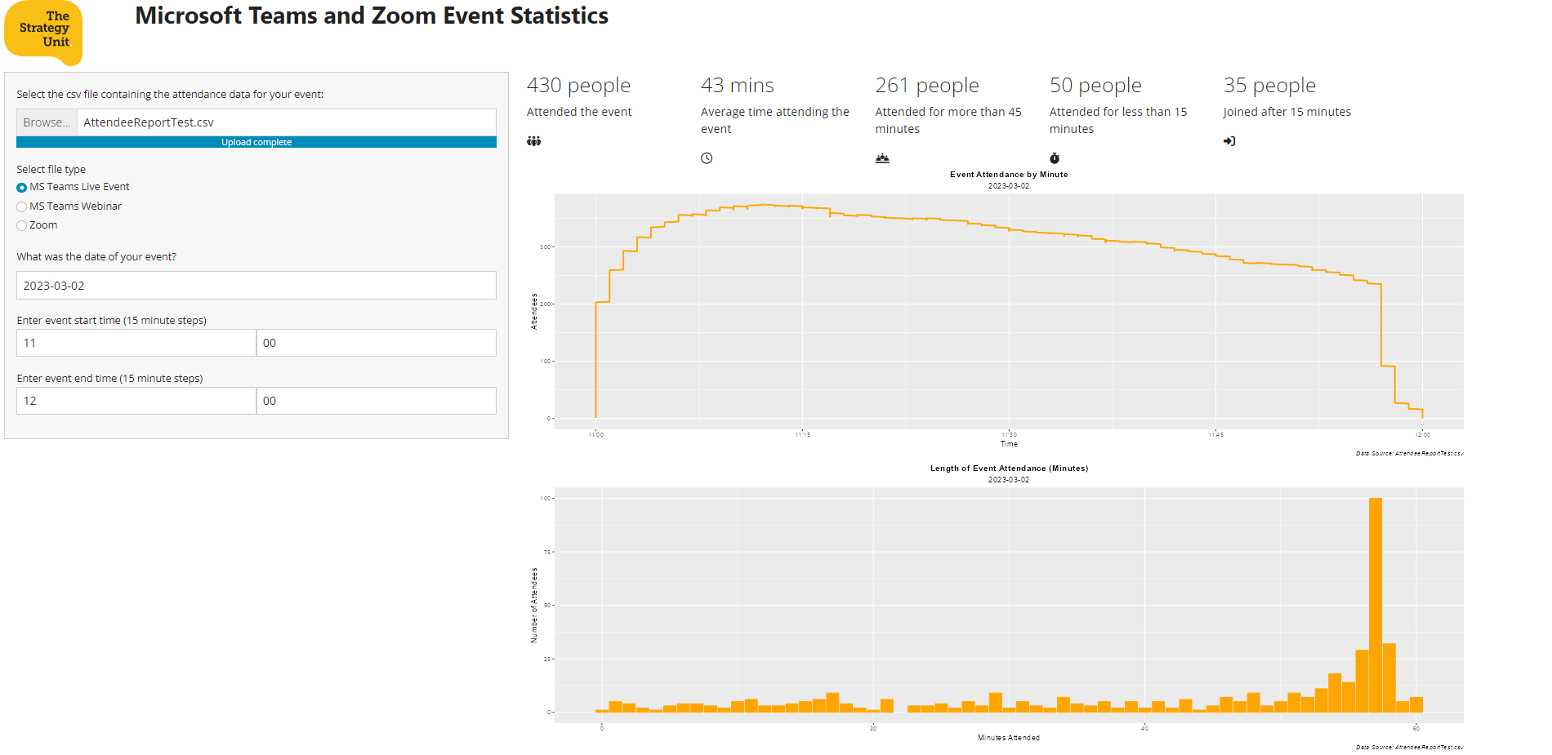

Slide 7
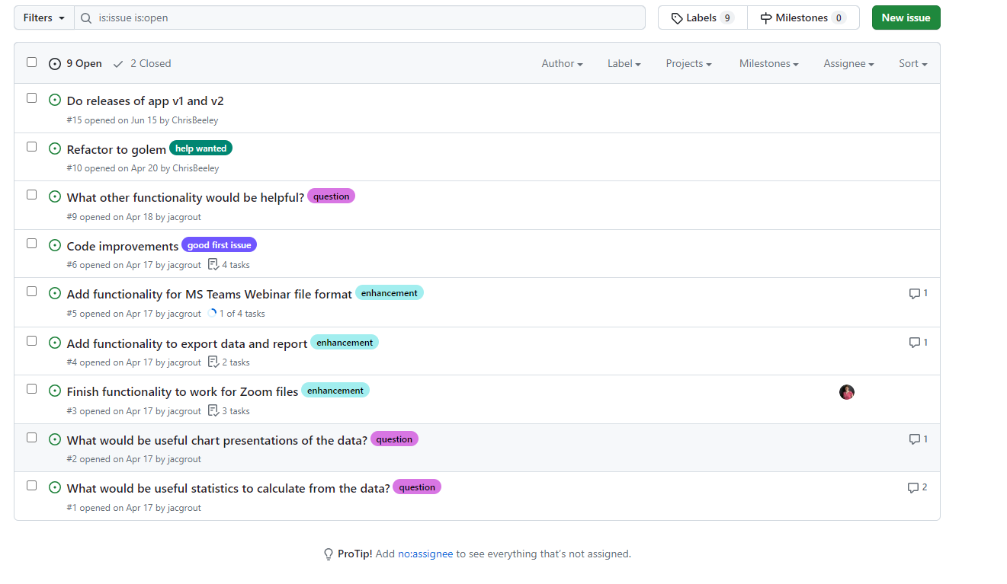

Slide 8
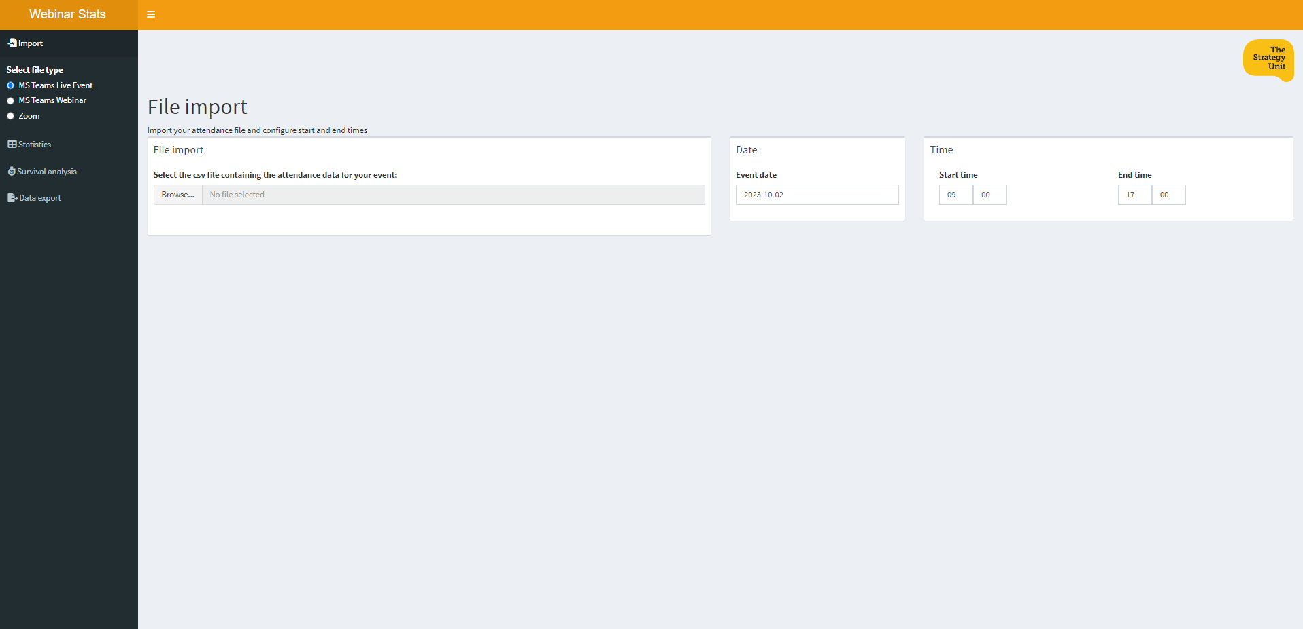
Notes:
Thus far we now have a Shiny app with functionality that allows selection of the attendee engagement report from a MS Teams Live Event, auto determines the date and timings of the event and generates statistics and chart presentations such as how many attended, how long they attended for, method of attending, promptness, and a survival analysis. It is also possible to export the cleaned up and organised attendance data, and to export presentations for use in project reports.

Slide 9
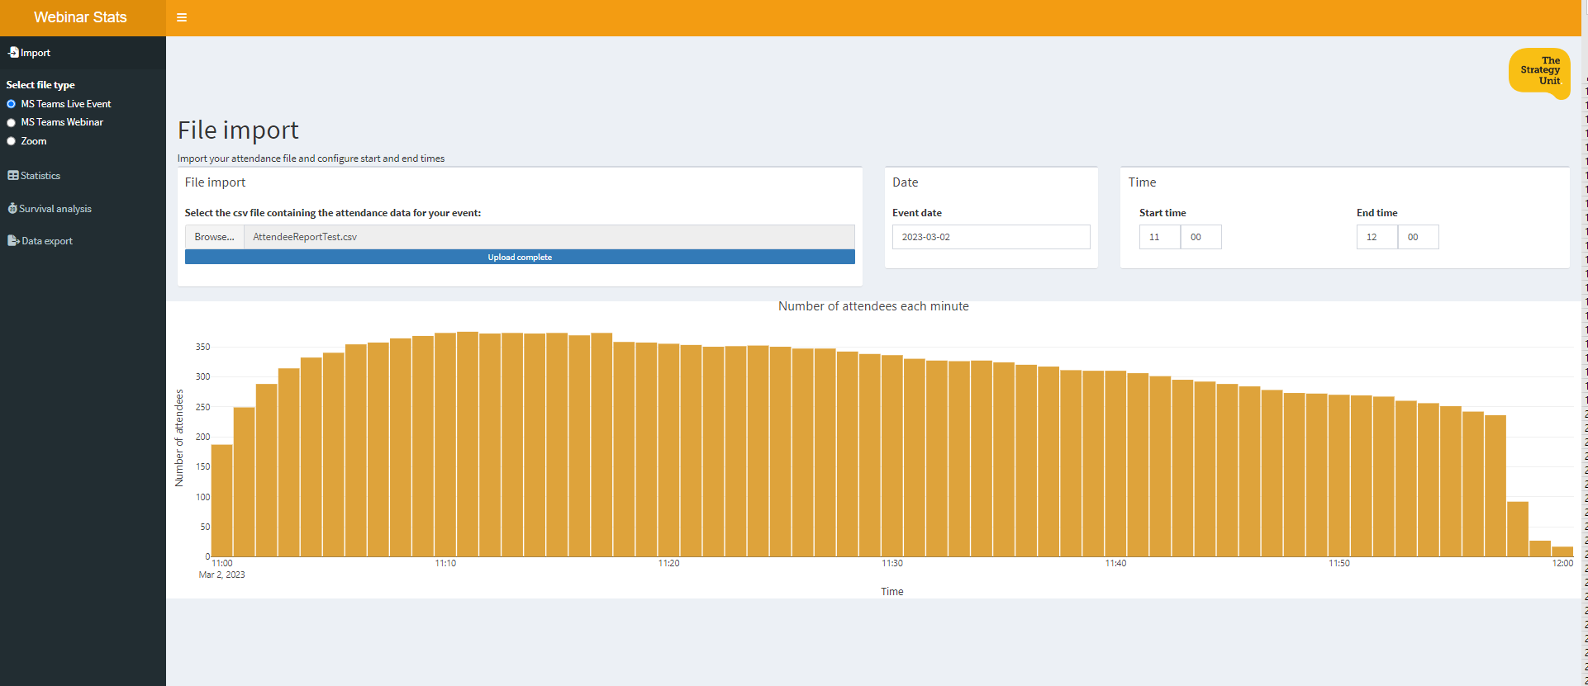

Slide 10
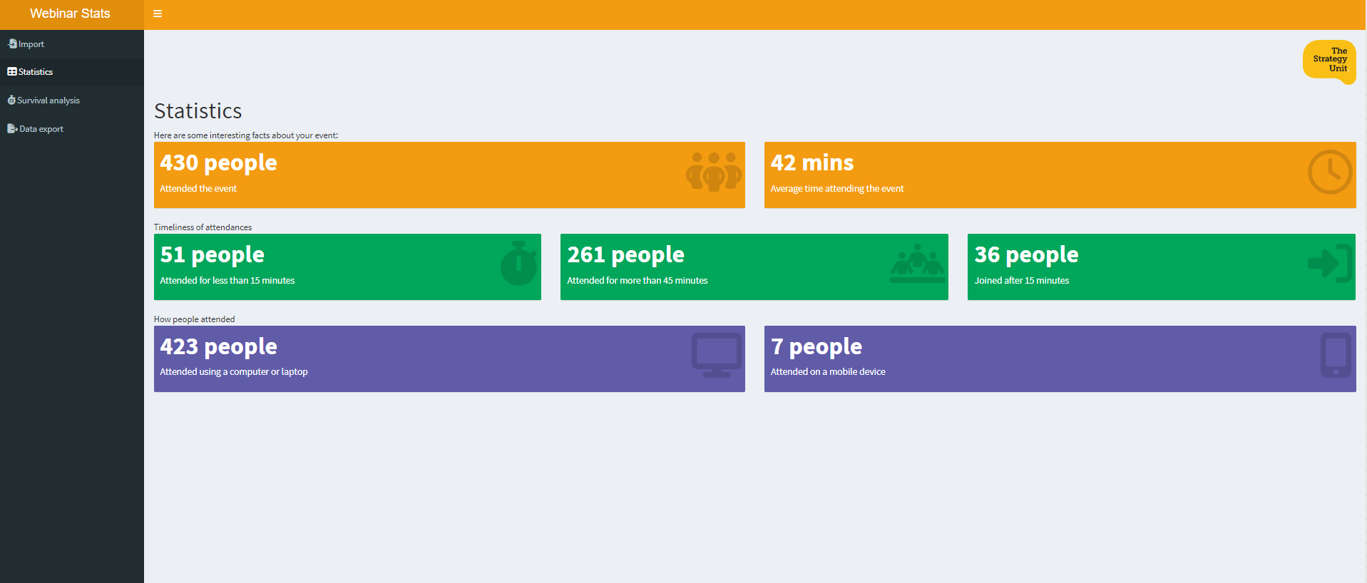



Slide 11
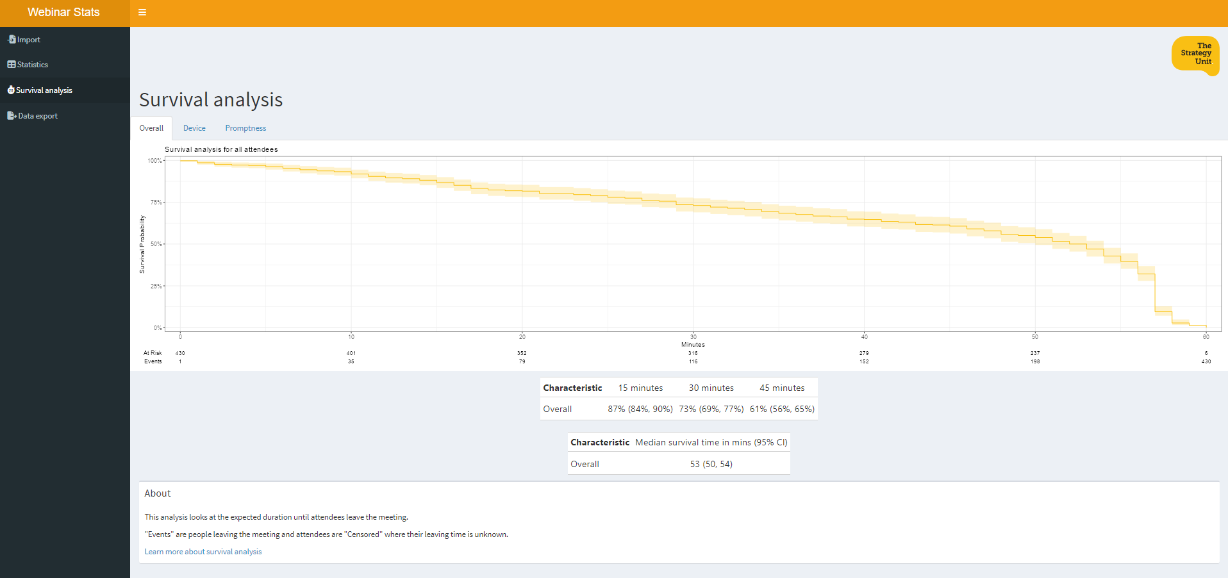

Slide 12
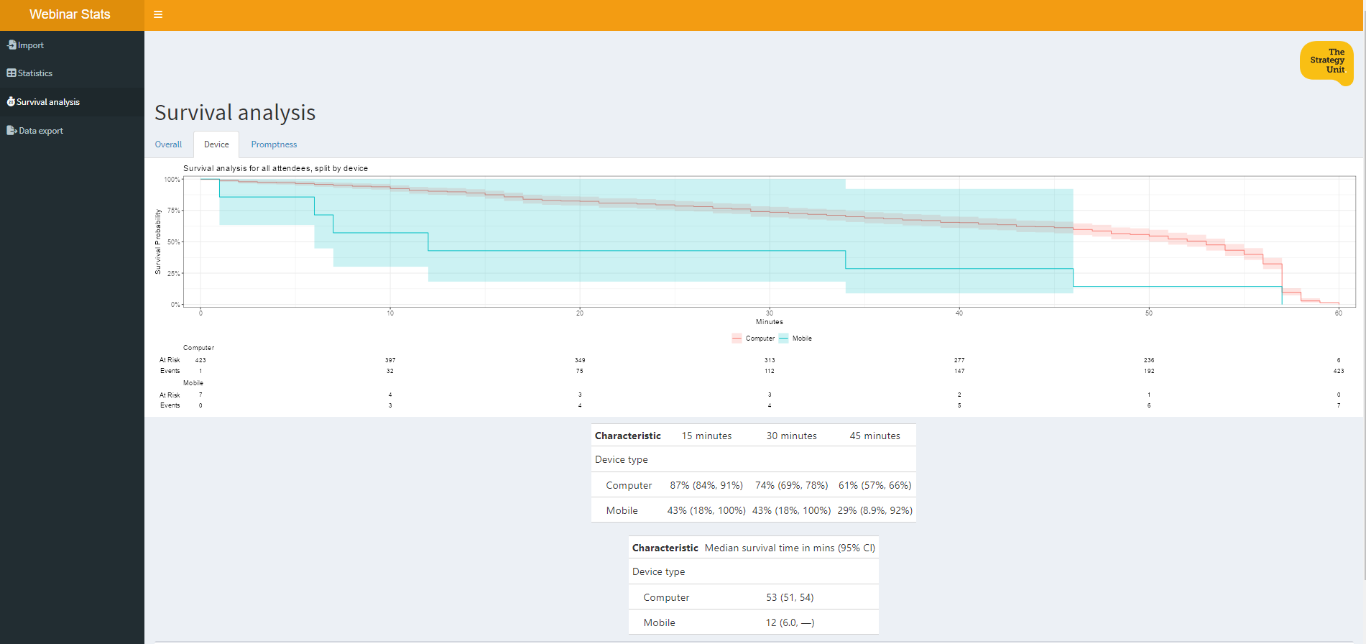

Slide 13
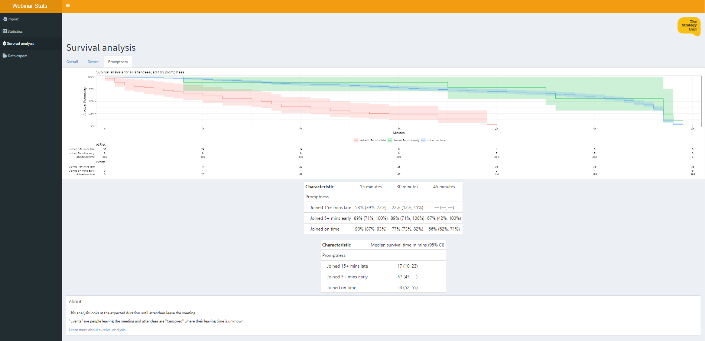




Slide 14
What next? – Collaborate on GitHub
Ideas for useful statistics to calculate from the data?
Ideas for useful chart presentations of the data?
What other functionality would be helpful?
It’s not organisation specific / limited
It makes a nice project to practice using and collaborating on GitHub
It’s a “would be nice” so no time pressure - it’s “low stakes”
Lots of small quick tasks to contribute
It demonstrates that a project is not just about “the code”
Notes:
The GitHub issues still include a number of suggestions for additional functionality and code improvements. So, if this project is of use and interest to you and you’re looking to develop your GitHub collaboration skills then visit the repository on GitHub and join in the fun.

Slide 15




Please get involved! (and help me get it finished because otherwise I never will)
https://github.com/The-Strategy-Unit/WebinarStats
https://www.strategyunitwm.nhs.uk/
@Strategy_Unit
jacqueline.grout1@nhs.net

